Slide 1
Online Ticket Booking System
21/10/2024

Slide 2
Ticket Booking System
Team Members:
Eman Ahmed Khattab
Rana Ibrahim Farag
Shrouk Khaled Alfaki
With the supervision of:
Eng. Gehad Abdo

Slide 3
SUMMARY
The Online Ticket Booking System provides an effective solution for users to manage ticket bookings for matches while allowing admins to control event details efficiently. The project has strengthened our skills in ASP.NET Core MVC development and provided insights into user experience design.

Slide 4
Objectives
To create an intuitive platform for users to view and book tickets for matches.
To implement user authentication and role-based access control for admins and regular users.
To allow admins to manage events (create, update, delete).
To provide users with personalized experience, including viewing their booking history.

Slide 5
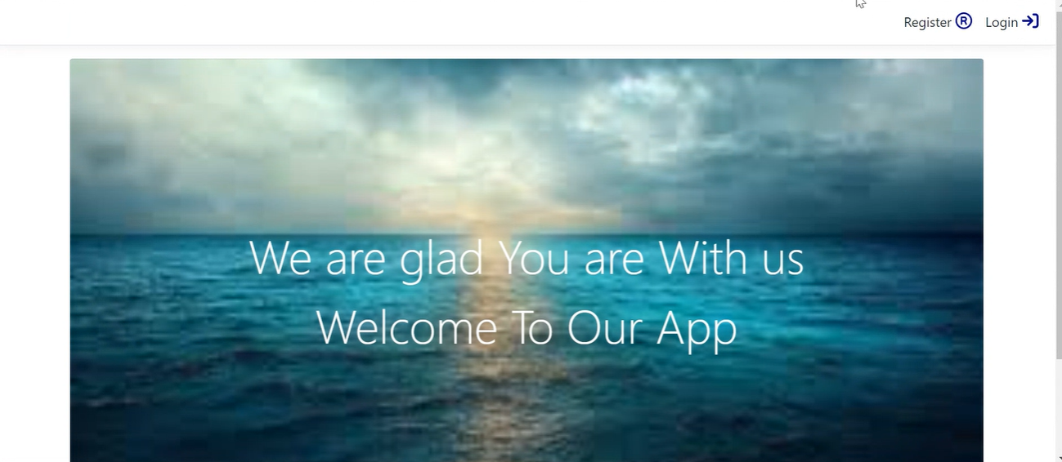
When running the application, the welcome page will be shown.

Slide 6
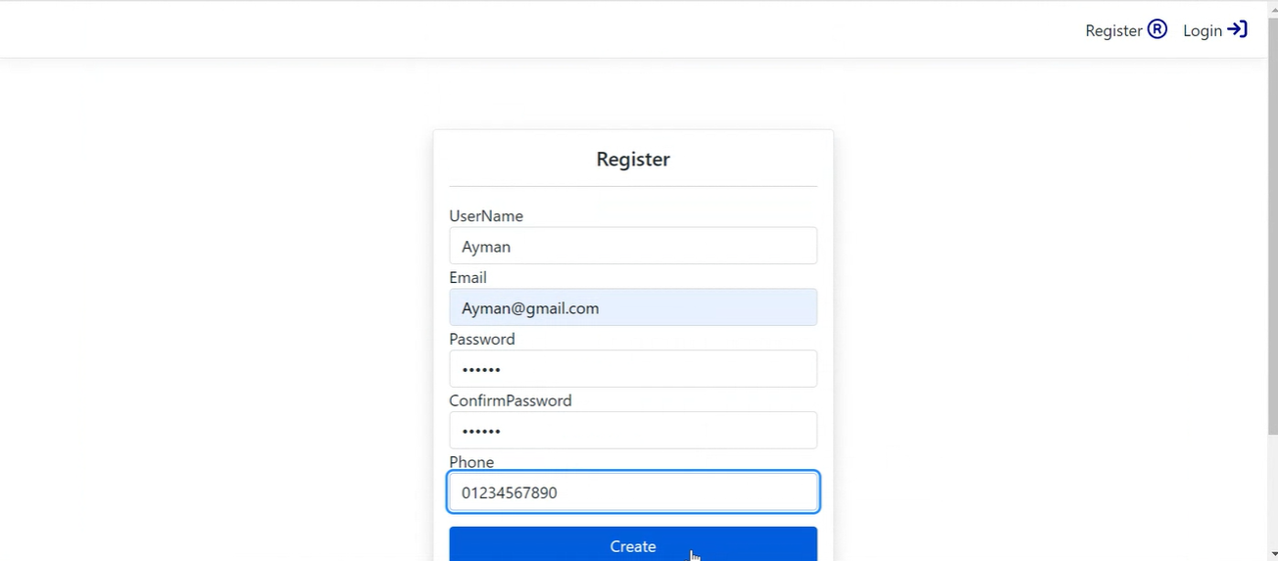
When clicking on Register , the client will be registered as a user by default.

Slide 7
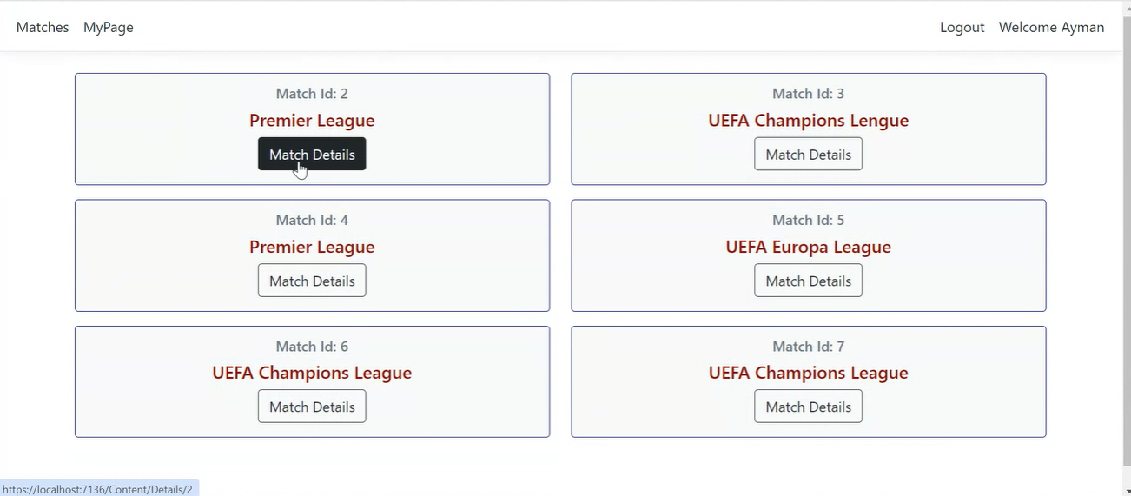
After registering, you will find a page with all available matches and you can view more details on each match.

Slide 8
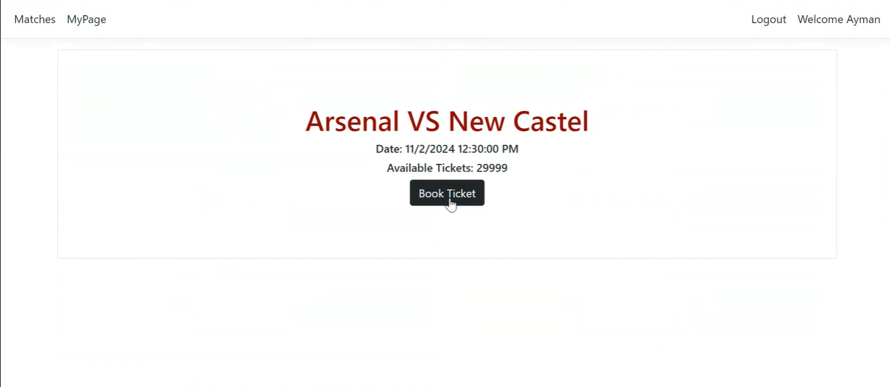
After clicking on the match you want , you can book a ticket if you want.

Slide 9
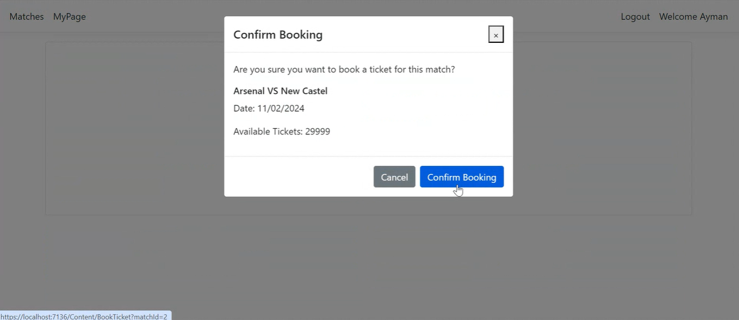
Here shows the confirmation message to book the ticket.

Slide 10
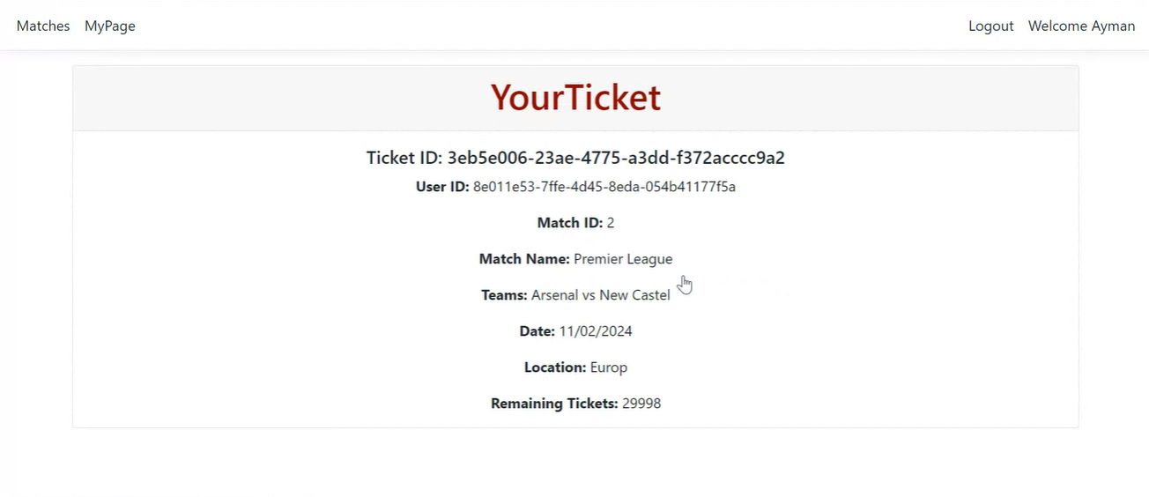
After the confirmation , your ticket will be shown as above.

Slide 11
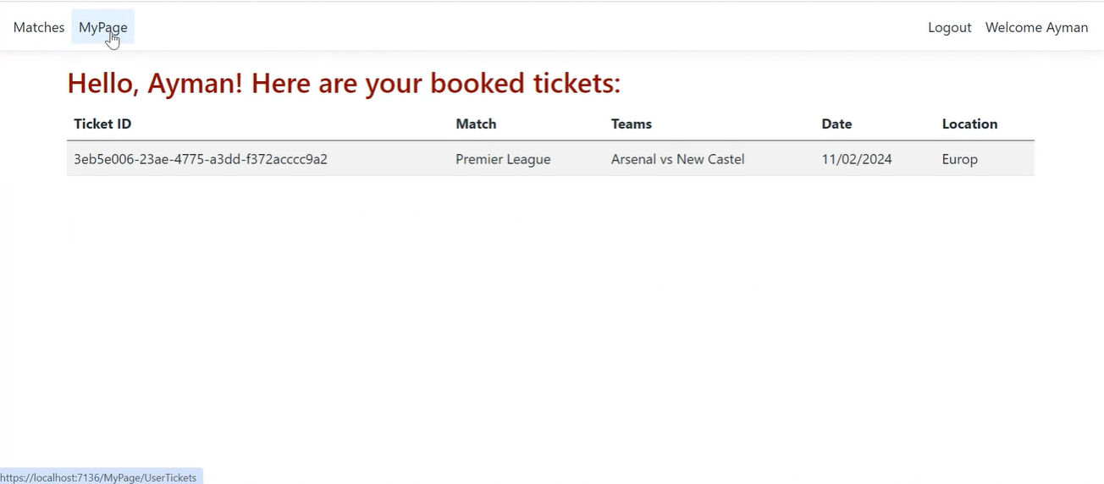
In MyPage page , you will find the tickets you have booked and details about the match.

Slide 12
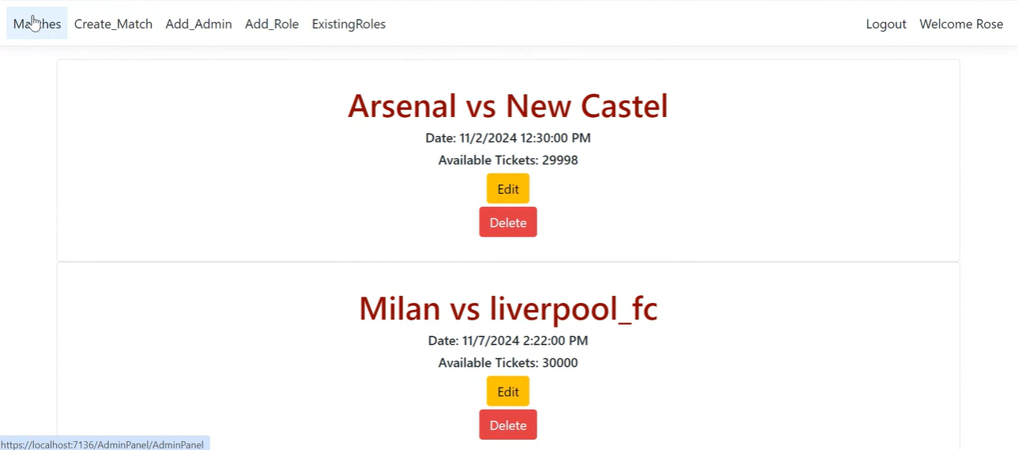
As you entered as a super admin , you will be able to see the list of matches in the matches page , edit them , or delete them.
With authentication , different actions will appear to the non-user administrator.

Slide 13
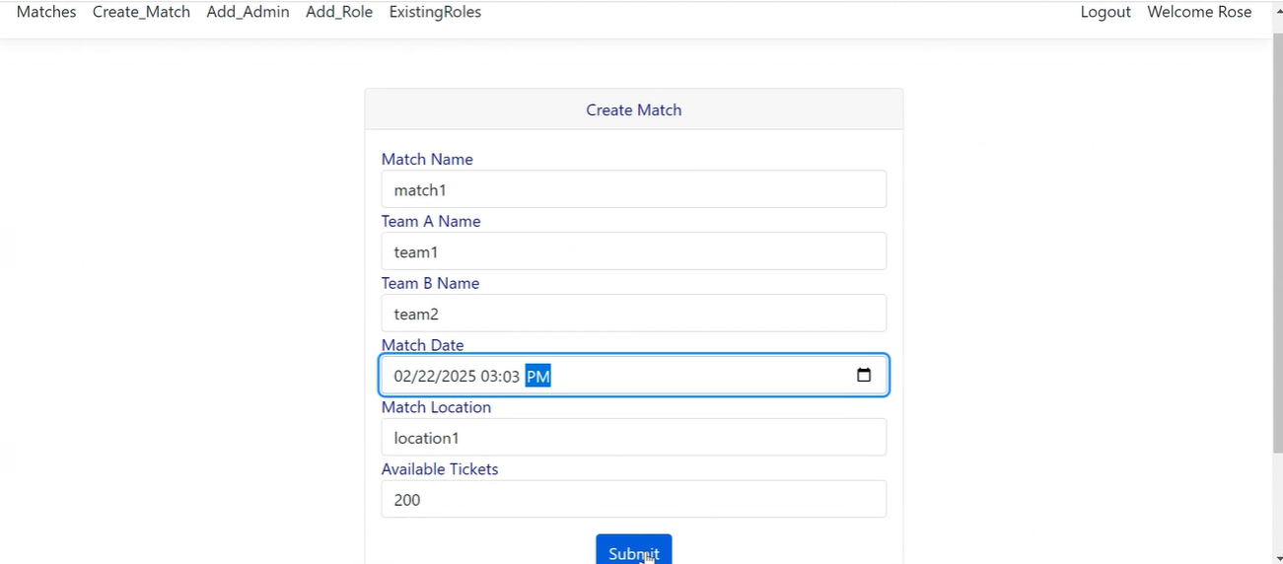
In the create_matches page , you can add the match's name , the teams that will play , date , location and the number of available tickets.

Slide 14
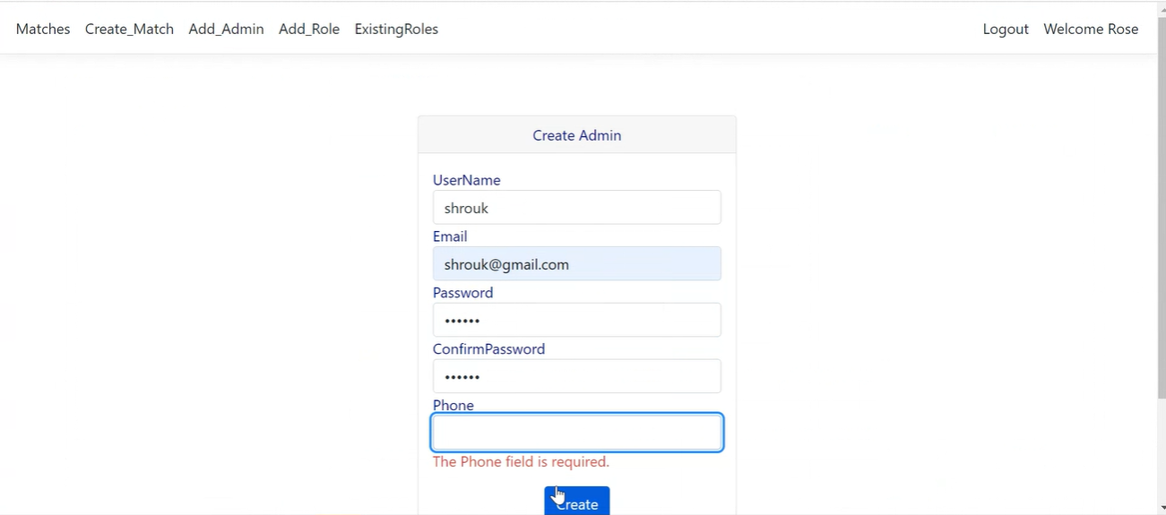
As you entered as a super admin , you will be the one who is making admins` accounts in the Add_Admin page.

Slide 15
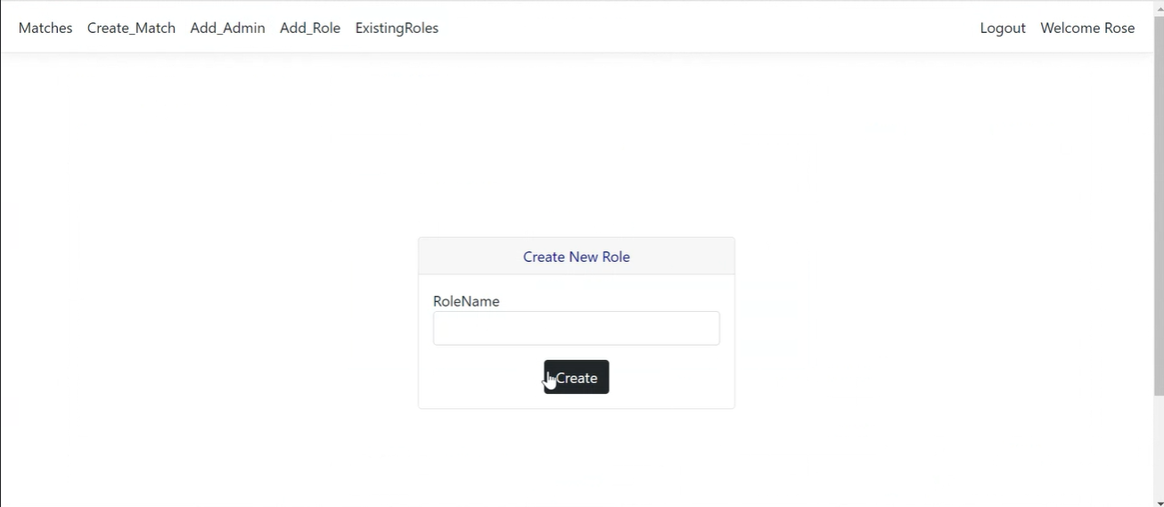
Also , you will be able to add a role to identities in the Add_Role page.

Slide 16
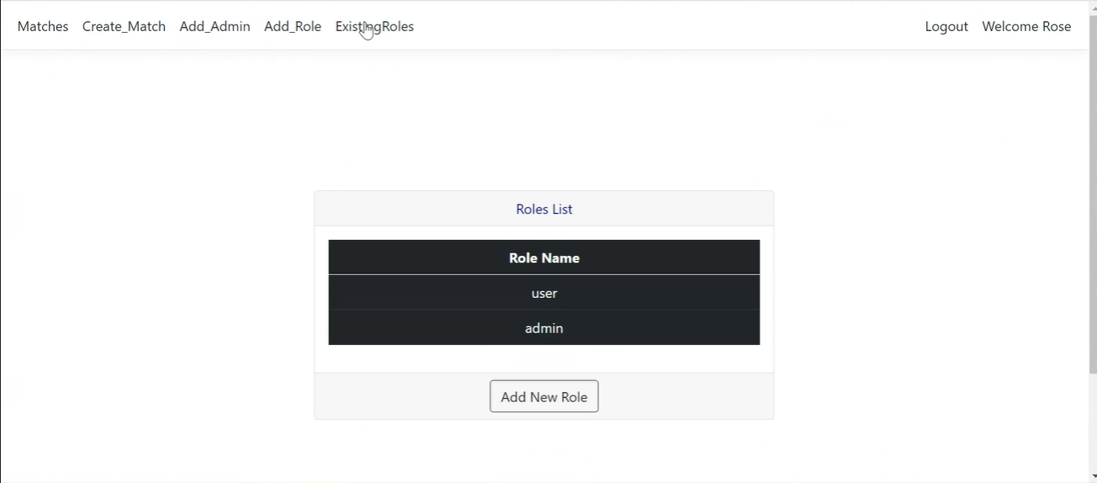
In the ExistingRoles page , you will see the roles that already exist.

Slide 17
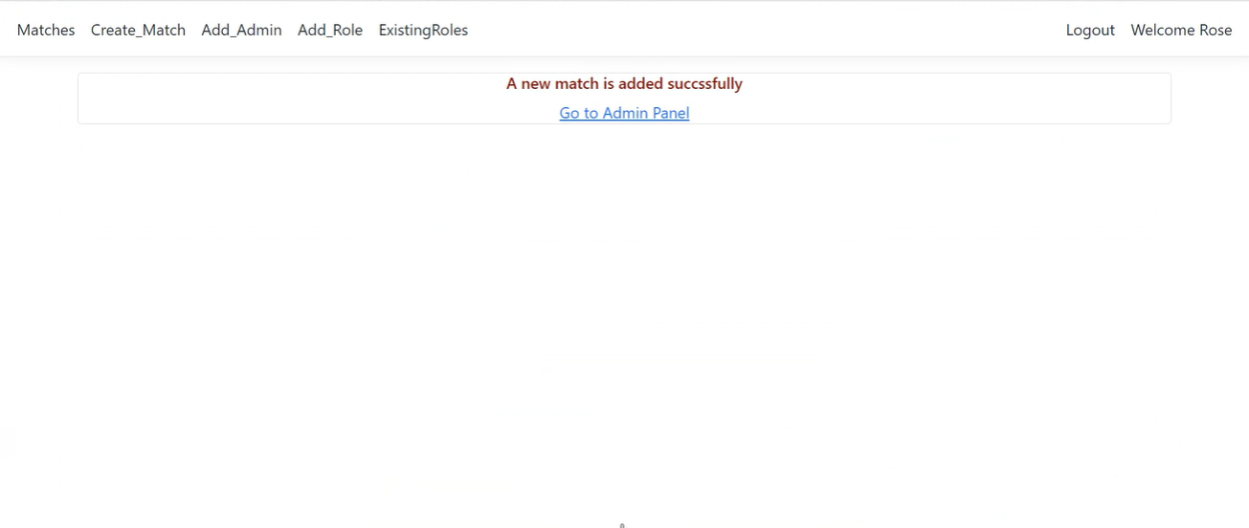
This page will be shown when adding a new match.

Slide 18
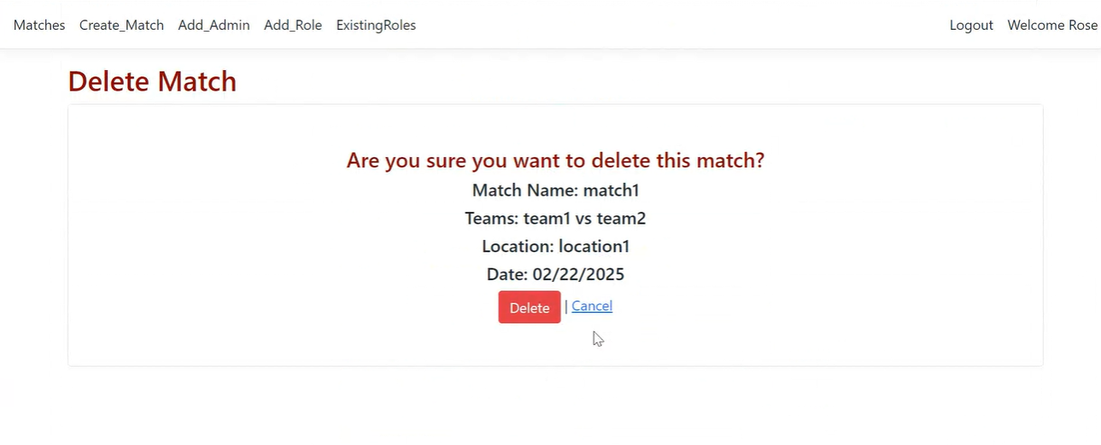
This window will be displayed if you wanted to delete a match.

Slide 19
Technologies
Backend-Side
Frontend-Side
Database
Authentication
Development Tools
HTML
CSS
JavaScript
SQL Server (Entity Framework Core).
ASP.NET Core Identity
Visual Studio Code
ASP.NET Core MVC

Slide 20
Thank You

